Slide 1

FUNDAMENTALS OF DATABASE SYSTEMS LESSON 8: Functional Dependencies and Normalization for Relational Databases
Department of Information Systems
University of Engineering and Technology,
Vietnam National University in Hanoi (UET-VNU)

Slide 2
Chapter Outline
Informal Design Guidelines for Relational Databases
Functional Dependencies (FDs)
Normal Forms Based on Primary Keys
General Normal Form Definitions (For Multiple Keys)
BCNF (Boyce-Codd Normal Form)

Slide 3
Informal Design Guidelines for Relational Databases
Functional Dependencies (FDs)
Normal Forms Based on Primary Keys
General Normal Form Definitions (For Multiple Keys)
BCNF (Boyce-Codd Normal Form)

Slide 4
Informal Design Guidelines for Relational Databases
What is relational database design?
The grouping of attributes to form "good" relation schemas
Two levels of relation schemas
The logical "user view" level
The storage "base relation" level
Design is concerned mainly with base relations
What are the criteria for "good" base relations?

Slide 5
Informal Design Guidelines for Relational Databases
We first discuss informal guidelines for good relational design
Then we discuss formal concepts of functional dependencies and normal forms
- 1NF (First Normal Form)
- 2NF (Second Normal Form)
- 3NF (Third Normal Form)
- BCNF (Boyce-Codd Normal Form)

Slide 6
Semantics of the Relation Attributes
GUIDELINE 1: Informally, each tuple in a relation should represent one entity or relationship instance.
Attributes of different entities (EMPLOYEEs, DEPARTMENTs, PROJECTs) should not be mixed in the same relation
Only foreign keys should be used to refer to other entities
Entity and relationship attributes should be kept apart as much as possible.
Bottom Line: Design a schema that can be explained easily relation by relation. The semantics of attributes should be easy to interpret.

Slide 7
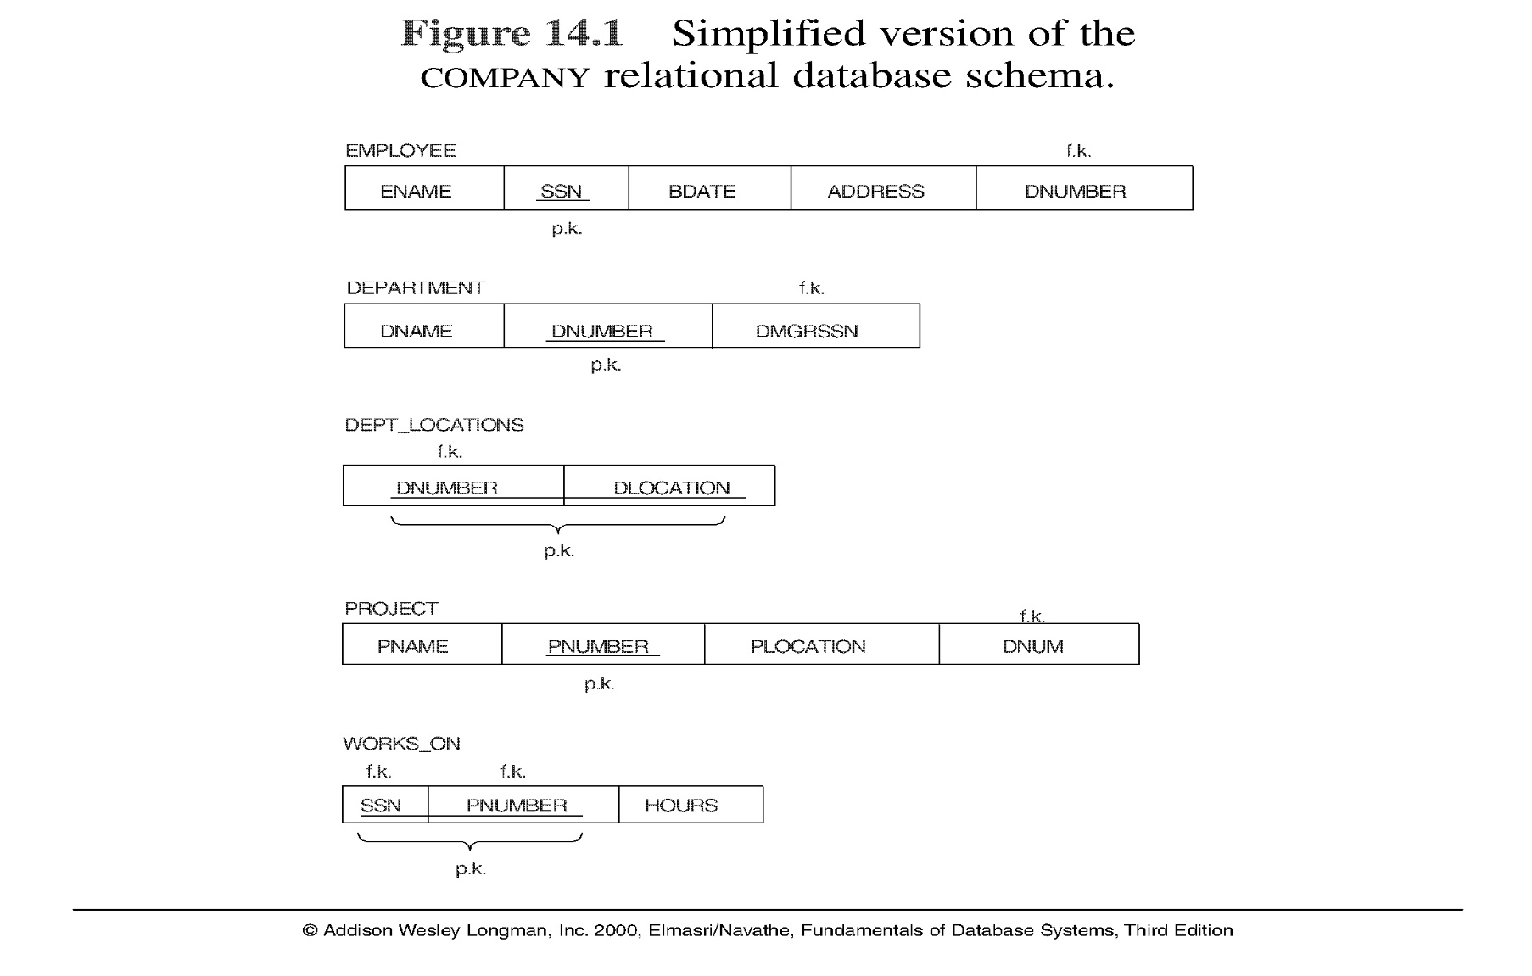
Figure :A simplified COMPANY relational database schema

Slide 8
Redundant Information in Tuples and Update Anomalies
Mixing attributes of multiple entities may cause problems
Information is stored redundantly wasting storage
Problems with update anomalies
Insertion anomalies
Deletion anomalies
Modification anomalies

Slide 9
EXAMPLE OF AN UPDATE ANOMALY
Consider the relation:
EMP_PROJ ( Emp#, Proj#, Ename, Pname, No_hours)
Update Anomaly: Changing the name of project number P1 from “Billing” to “Customer-Accounting” may cause this update to be made for all 100 employees working on project P1.

Slide 10
EXAMPLE OF AN UPDATE ANOMALY
Insert Anomaly: Cannot insert a project unless an employee is assigned to .
Inversely - Cannot insert an employee unless an he/she is assigned to a project.
Delete Anomaly: When a project is deleted, it will result in deleting all the employees who work on that project. Alternately, if an employee is the sole employee on a project, deleting that employee would result in deleting the corresponding project.

Slide 11
NHANVIEN_PHONG
Manv | Ho | Dem | Ten | Donvi | Maql
11001 | Trần | Văn | An | Nghiên cứu | 11001
11002 | Lê | Đình | Bắc | Đào tạo | 11002
11003 | Trần | Thị | Hảo | Đào tạo | 11002
11004 | Vũ | Đức | Lâm | Hành chính | 11005
11005 | Phạm | Hải | Ngọc | Hành chính | 11005
11006 | Trần | Văn | Cường | Nghiên cứu | 11001
11007 | Vũ | Vân | Long | Đào tạo | 11002
Dư thừa về Đơn vị / Người quản lý

Slide 12
Dư thừa
SV_MONHOC
Masv | Ho | Dem | Ten | Mamon | Tenmon | Diem
T1 | Trần | Văn | An | Int1001 | CSDL | 8
T1 | Trần | Văn | An | Int1002 | NNLT | 9
C2 | Lê | Đình | Bắc | Int1003 | TRR | 7
C2 | Lê | Đình | Bắc | Int1002 | NNLT | 3
T3 | Trần | Thị | Hảo | Int1003 | TRR | 10
T4 | Vũ | Đức | Lâm | Int1002 | NNLT | 8
C2 | Lê | Đình | Bắc | Int1001 | CSDL | 8
T4 | Vũ | Đức | Lâm | Int1001 | CSDL | 7
C3 | Phạm | Hải | Ngọc | Int1003 | TRR | 6

Slide 13
SV_DIEM
Masv | Ho | Dem | Ten | TRR | CSDL | NNLT | TB | Xeploai
T1 | Trần | Văn | An | 7 | 6 | 8 | 7.0 | Khá
T2 | Trần | Thị | Hảo | 8 | 8 | 10 | 8.7 | Giỏi
T3 | Vũ | Đức | Lâm | 5 | 9 | 8 | 7.3 | Khá
T4 | Phạm | Hải | Ngọc | 6 | 5 | 6 | 5.7 | Tbình
Dư thừa

Slide 14
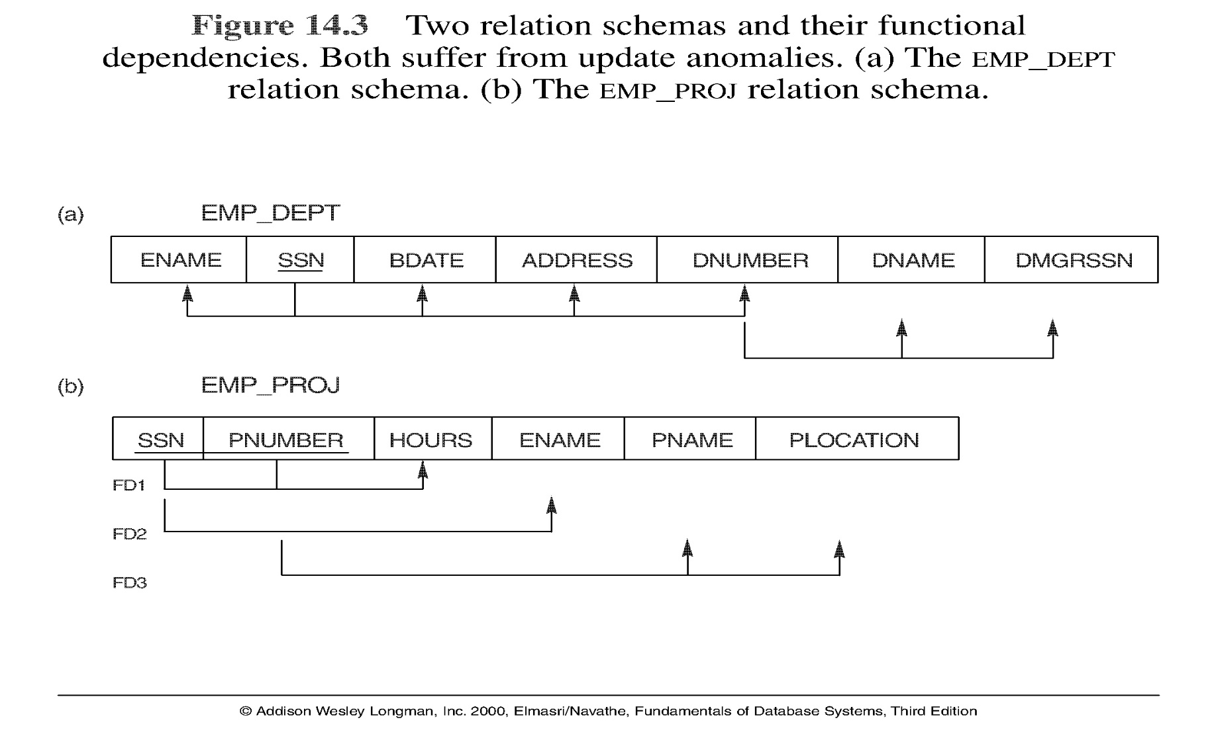
Figure Two relation schemas suffering from update anomalies

Slide 15
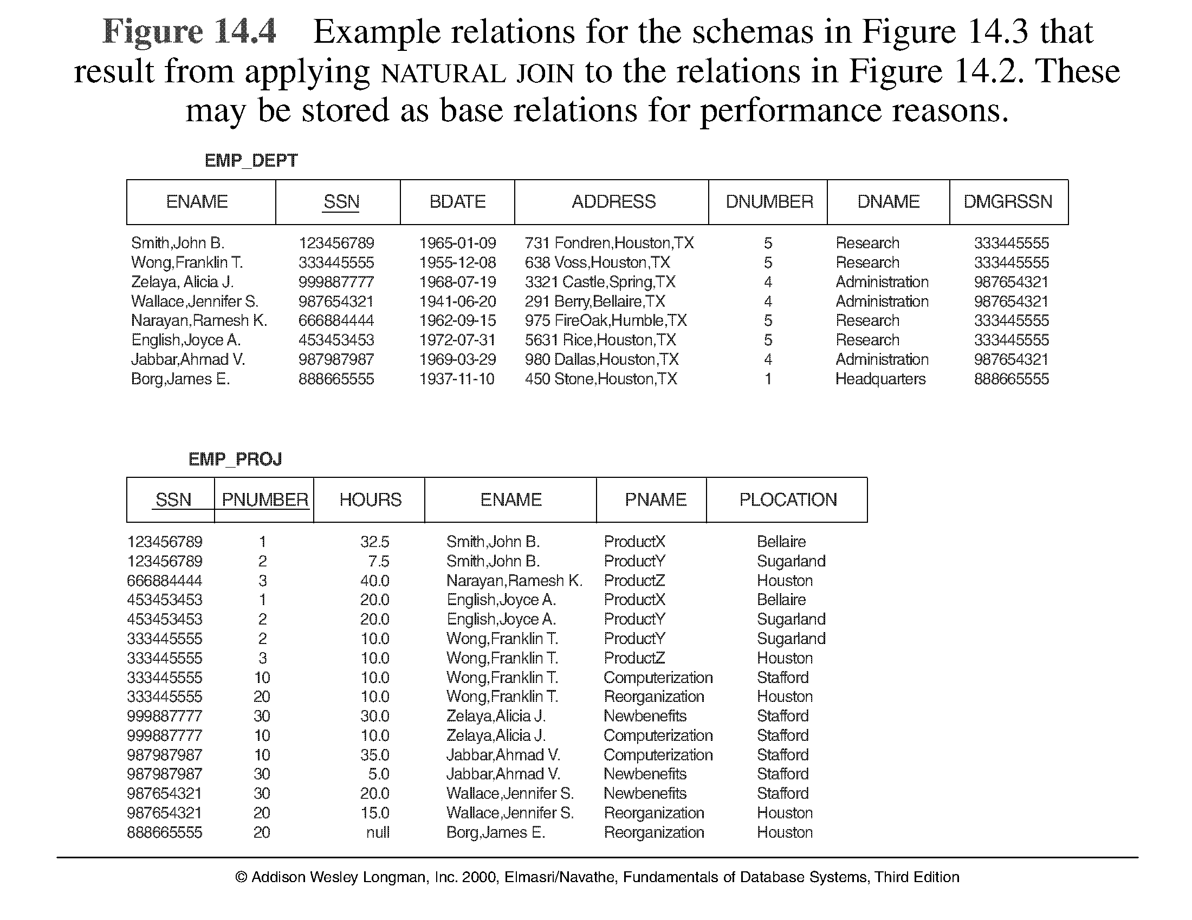
Figure Example States for EMP_DEPT and EMP_PROJ

Slide 16
Guideline to Redundant Information in Tuples and Update Anomalies
GUIDELINE 2: Design a schema that does not suffer from the insertion, deletion and update anomalies. If there are any present, then note them so that applications can be made to take them into account

Slide 17
Null Values in Tuples
GUIDELINE 3: Relations should be designed such that their tuples will have as few NULL values as possible
Attributes that are NULL frequently could be placed in separate relations (with the primary key)
Reasons for nulls:
attribute not applicable or invalid
attribute value unknown (may exist)
value known to exist, but unavailable

Slide 18
Spurious Tuples
Bad designs for a relational database may result in erroneous results for certain JOIN operations
The "lossless join" property is used to guarantee meaningful results for join operations
GUIDELINE 4: The relations should be designed to satisfy the lossless join condition. No spurious tuples should be generated by doing a natural-join of any relations.

Slide 19
Spurious Tuples (2)
There are two important properties of decompositions:
non-additive or losslessness of the corresponding join
preservation of the functional dependencies.
Note that property (a) is extremely important and cannot be sacrificed. Property (b) is less stringent and may be sacrificed.

Slide 20
Informal Design Guidelines for Relational Databases
Functional Dependencies (FDs)
Normal Forms Based on Primary Keys
General Normal Form Definitions (For Multiple Keys)
BCNF (Boyce-Codd Normal Form)

Slide 21
2.1 Functional Dependencies (1)
Functional dependencies (FDs) are used to specify formal measures of the "goodness" of relational designs
FDs and keys are used to define normal forms for relations
FDs are constraints that are derived from the meaning and interrelationships of the data attributes
A set of attributes X functionally determines a set of attributes Y if the value of X determines a unique value for Y

Slide 22
Functional Dependencies (2)
X -> Y holds if whenever two tuples have the same value for X, they must have the same value for Y
For any two tuples t1 and t2 in any relation instance r(R): If t1[X]=t2[X], then t1[Y]=t2[Y]
X -> Y in R specifies a constraint on all relation instances r(R)
Written as X -> Y; can be displayed graphically on a relation schema as in Figures. ( denoted by the arrow: ).
FDs are derived from the real-world constraints on the attributes

Slide 23
Examples of FD constraints (1)
social security number determines employee name
SSN -> ENAME
project number determines project name and location
PNUMBER -> {PNAME, PLOCATION}
employee ssn and project number determines the hours per week that the employee works on the project
{SSN, PNUMBER} -> HOURS

Slide 24
Examples of FD constraints (2)
An FD is a property of the attributes in the schema R
The constraint must hold on every relation instance r(R)
If K is a key of R, then K functionally determines all attributes in R (since we never have two distinct tuples with t1[K]=t2[K])

Slide 25
2.2 Inference Rules for FDs (1)
Given a set of FDs F, we can infer additional FDs that hold whenever the FDs in F hold
Armstrong's inference rules:
IR1. (Reflexive) If Y subset-of X, then X -> Y
IR2. (Augmentation) If X -> Y, then XZ -> YZ
(Notation: XZ stands for X U Z)
IR3. (Transitive) If X -> Y and Y -> Z, then X -> Z
IR1, IR2, IR3 form a sound and complete set of inference rules

Slide 26
Inference Rules for FDs (2)
Some additional inference rules that are useful:
(Decomposition) If X -> YZ, then X -> Y and X -> Z
(Union) If X -> Y and X -> Z, then X -> YZ
(Psuedotransitivity) If X -> Y and WY -> Z, then WX -> Z
The last three inference rules, as well as any other inference rules, can be deduced from IR1, IR2, and IR3 (completeness property)

Slide 27
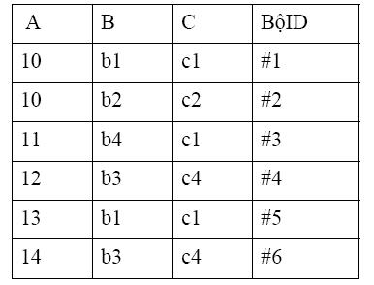
Exercise 1
Which is a correct FD ? Explain :
A → B , B → C, C → B, B → A,
C → A.

Slide 28
Closure of a set
Closure of a set F of FDs is the set F⁺ of all FDs that can be inferred from F
F = {X→ Y , Y→ Z }
F⁺ = {X→ Y , Y→ Z , X→ Z , X→ YZ}
F⁺ = F ∪ { f / F |= f}

Slide 29
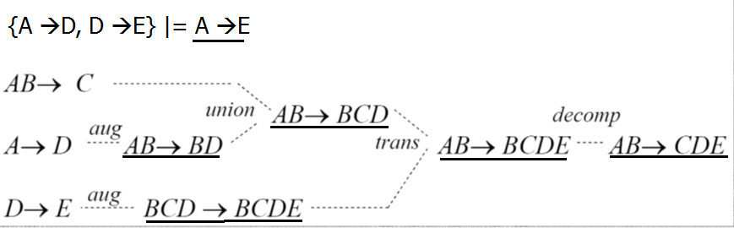
Example
F= {AB→C; A→D, D →E}
Find F⁺
F⁺= F ∪{A →E, AB →BD, AB→BCD , AB→BCDE, BCD→BCDE, AB→CDE }

Slide 30
Closure of a set
Closure of a set of attributes X with respect to F is the set X ⁺ of all attributes that are functionally determined by X
X ⁺ can be calculated by repeatedly applying IR1, IR2, IR3 using the FDs in F
X⁺_{F} = { A ∈ U st. X → A ∈ F⁺}
Example: DA(Manv, Hoten, Mada, Tenda, DD, Sogio}
F ={ Manv ->Hoten; Mada->Tenda, DD; Manv, Mada->Sogio}
{Manv}⁺ =
{Manv, Hoten}
{Mada}⁺ =
{Mada, Tenda, DD}
{Manv, Mada}⁺ =
{Manv, Hoten, Mada, Tenda, DD, Sogio}

Slide 31
X →Y is inferred from closure set of F according to Armstrong rules iff Y ⊆ X⁺_{F}
Ví dụ 1: Cho F={ AB → C, A → D, D → E, AC →B}
Xác định các bao đóng sau:
A⁺ =
{A, D,E }
F |= AB→ E ?
F |= D→C ?
F |= AD →CDE ?
F |=AB →CDE
AB⁺ =
{A, B, C, D, E }
B⁺ =
{B}
D⁺ =
{D, E}
AD⁺ =
{A, D, E}

Slide 32
Example
Cho F ={ A → B, C → DE, AC →F}
Xác định các bao đóng sau:
A⁺ =
{A, B }
F |= A→ E ?
F |= AC→BDF ?
C⁺ =
{C, D, E }
AC⁺ =
{A, B, C, D, E, F}

Slide 33
Nhập môn Cơ sở Dữ liệu
Algorithm for computing the closure of a set
X⁺ = X;
Repeat
Old X⁺ = X⁺ ;
For each FD Y → Z in F
if X⁺ ⊃ Y then X⁺ = X⁺ ∪ Z;
Until ( X⁺ = Old X⁺ );

Slide 34
Example of computing the closure of a set
Ex1: F ={ A → D, E →H , AB → DE, CE →G}
Compute {ABC}⁺
Let X+ = {ABC}
Old X+ = X⁺
With FD A → D, we have X⁺ = {ABCD}
With FD E → H , we have X⁺ = {ABCD}
With FD AB → DE , we have X⁺ = {ABCDE}
With FD CE → G , we have X⁺ = {ABCDEG}
…….
With FD E → H , we have X⁺ = {ABCDEGH}
..
Then {ABC}⁺ = {ABCDEGH}

Slide 35
Example of computing the closure of a set
Ex 2: Cho R(ABCDEG), tìm {AB }⁺ với tập phụ thuộc hàm :
Initializing: X⁺ ={AB}
With (a): X⁺ ={ABC}
With (b): X⁺ ={ABCD}
With (c): X⁺ ={ABCDE}
With (d): X⁺ ={ABCDE}

Slide 36
Example of computing the closure of a set
Ex. 3: F ={ AG → I, BE →I,E →G, AB → E, GI →H}
Proving that F |= AB →GH using closure computing method
Ex. 4: F ={ A → D, B →C,BC →EF, D →G}
Proving that F |= AB →EFG using closure computing method
Ex. 5: The relation R with
F ={ AB→ C, B →D, CD →E, CE →GH, G →A}
Proving the following FD using closure computing method
AB → E
AB→ GH

Slide 37
2.3 Equivalence of Sets of FDs
Two sets of FDs F and G are equivalent if:
- every FD in F can be inferred from G, and
- every FD in G can be inferred from F
Hence, F and G are equivalent if F ⁺ =G ⁺
Definition: F covers G if every FD in G can be inferred from F (i.e., if G ⁺ subset-of F ⁺)
F and G are equivalent if F covers G and G covers F
There is an algorithm for checking equivalence of sets of FDs

Slide 38
Example of Equivalence of Sets of FDs
Cho 2 tập phụ thuộc hàm
F = {A →C, AC → D, E→AD, E →H }
E = { A →CD, E → AH }
Chứng minh E tương đương F ?
Cần chứng minh các phụ thuộc hàm của E suy dẫn được từ F và ngược lại
Cách 1: Dùng quy tắc suy diễn để chứng minh
Cách 2: Dùng bổ đề về bao đóng

Slide 39
Example of Equivalence of Sets of FDs
F = {A →C, AC → D, E→AD, E →H }
E = { A →CD, E → AH }
Kiểm tra xem E tương đương F ?
Cách 1: Dùng các quy tắc suy diễn
{A →C} |= {A → AC}
{AC → D}
|= {A →D}
|= {A →CD}
kết hợp với {A →C}
Vậy F |= {A →CD}
{E →AD} |= {E → A}
{E → H}
|= {E →AH}
Vậy F |= {E →AH}
Tức là F phủ E

Slide 40
F = {A →C, AC → D, E→AD, E →H }
E = { A →CD, E → AH }
Kiểm tra xem E tương đương F ?
Cách 1: Dùng các quy tắc suy diễn
Tương tự: chứng minh được
E phủ F
Tức là F tương đương E

Slide 41
Nhập môn Cơ sở Dữ liệu
F = {A →C, AC → D, E→AD, E →H }
E = { A →CD, E → AH }
Kiểm tra xem E tương đương F ?
Cách 2: Dùng bổ đề về bao đóng và suy diễn để chứng minh
{A}⁺_{F} = {ACD}
{A}⁺_{E} = {ACD}
{E}⁺_{F} = {ADEH}
{AC}⁺_{E} = {ACD}
{E}⁺_{E} = {ACDEH}
vậy F phủ E
vậy E phủ F
tức là E,F tương đương

Slide 42
2.4 Minimal Sets of FDs (1)
A set of FDs is minimal if it satisfies the following conditions:
Every dependency in F has a single attribute for its RHS.
We cannot remove any dependency from F and have a set of dependencies that is equivalent to F.
We cannot replace any dependency X -> A in F with a dependency Y -> A, where Y proper-subset-of X ( Y subset-of X) and still have a set of dependencies that is equivalent to F.

Slide 43
Minimal Sets of FDs (2)
Every set of FDs has an equivalent minimal set
There can be several equivalent minimal sets
There is no simple algorithm for computing a minimal set of FDs that is equivalent to a set F of FDs
To synthesize a set of relations, we assume that we start with a set of dependencies that is a minimal set (e.g., see algorithms 11.2 and 11.4)

Slide 44


